Slide 1
POSGCD Update
10/07/2024
Draft - Confidential

Slide 2
Overview of Work Scope
Network and Database setup for monitoring locations
Creating and formatting the Wellntel database for the data being added
Filling in historical data to bring record current
System configuration/programming
Map Halff and In-Situ API configuration to document data framework and to create rules/ protocols
Create programming-based instructions and alerts to ensure reliable communication
Automate script for data-record generation and monthly reporting
Draft - Confidential

Slide 3
Overview of Work Status
Work Status:
Regional and Sponsor description and charting overview
PO - Wellntel Locations - live and real-time data - complete
PO - PT Locations - In-Situ data pulled daily via API - complete
Sandow Lakes Ranch - reported data manual upload with one month Lag - complete
PO - Manual Locations - Halff data pulled daily via API - complete
Vista Ridge - reported data manual upload with one month Lag - received most information from S. Young EOD 10/4, 2024 data still outstanding, 700K readings, individual files, ~2 weeks to completion
Draft - Confidential

Slide 4
Data Source and Quantity
Source | Readings | Systems | Avg
Wellntel | 1,992,105 | 37 | 53841
Manual Wnt | 1,370 | 50 | 27
Manual PT | 304 | 7 | 43
Manual nonco | 492 | 35 | 14
Manual Total | 2,166 | 92 | 24
PT | 114,142 | 27 | 4227
SLR | 282,727 | 25 | 11309
Vista Ridge* | 700,000 | 18 | 38889
Total | 3,093,306 | 291 | 10630
*Complete in 2 weeks
Draft - Confidential

Slide 5
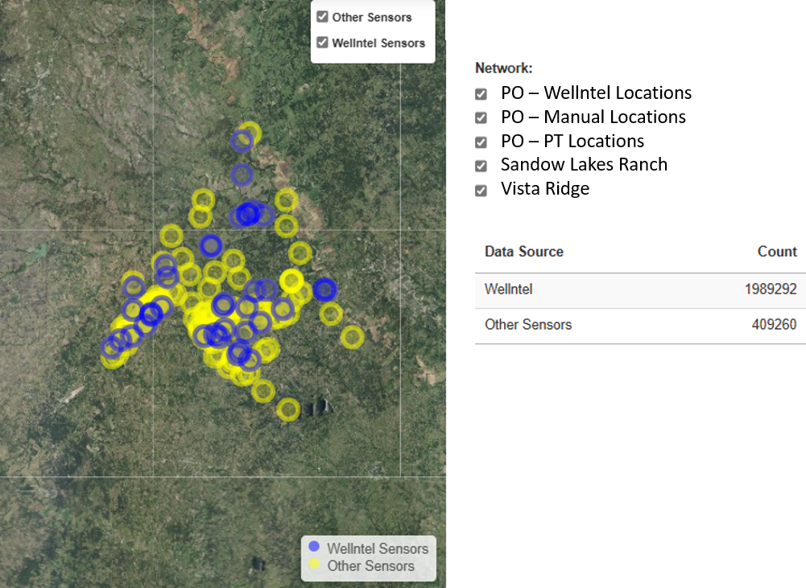
Draft - Confidential

Slide 6
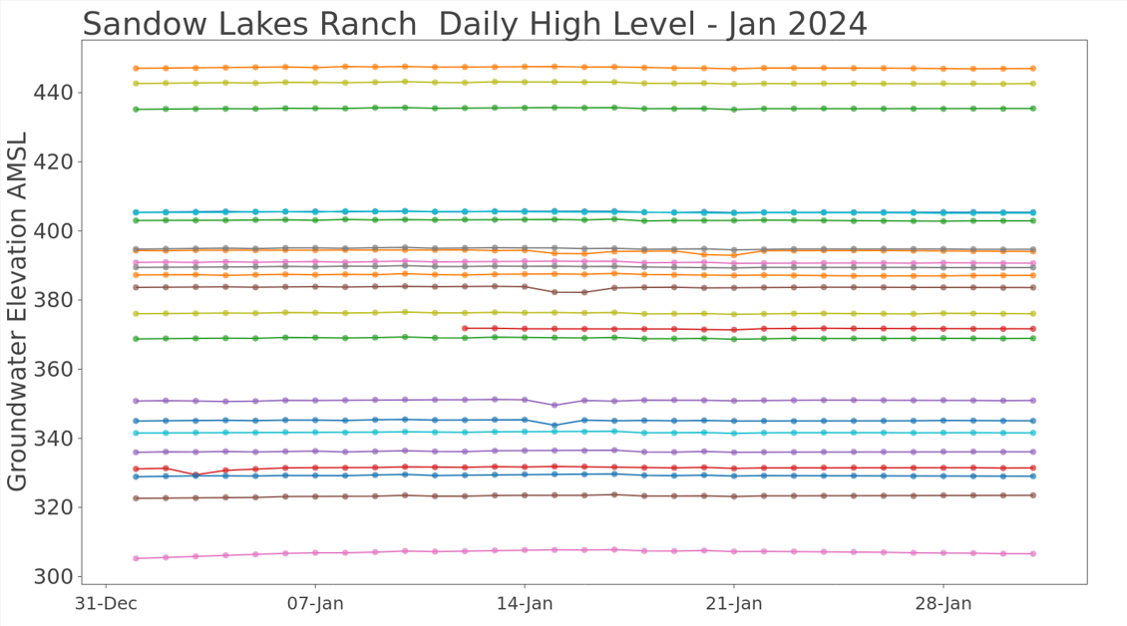
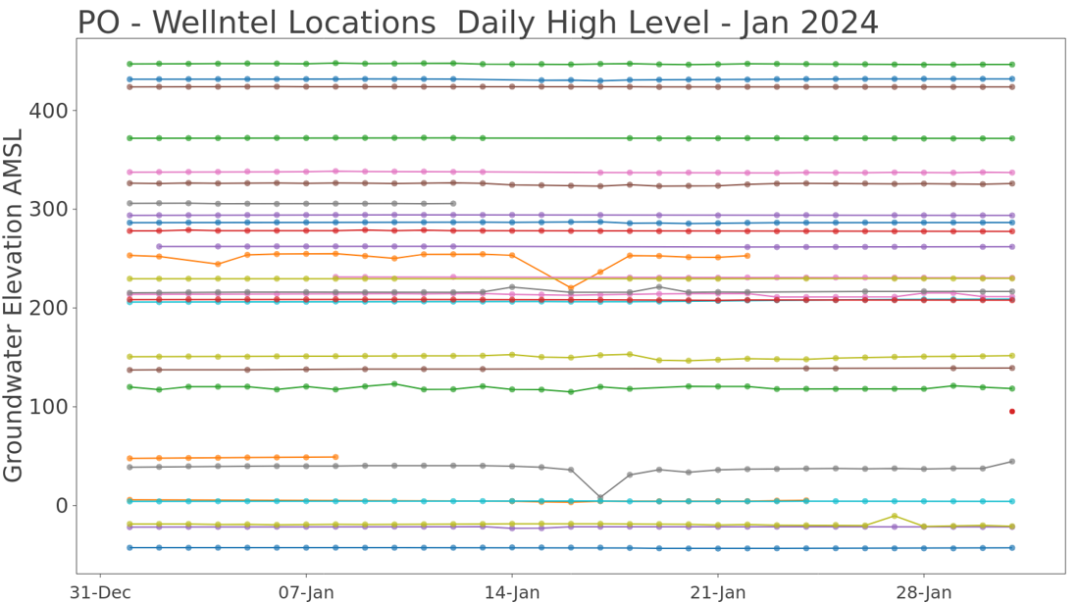
Just two examples
Draft - Confidential

Slide 7
Next steps
Logins and Credentials
Brainstorm formats and types of information to be shared publicly
Draft - Confidential

