Slide 1
Board Meeting
Post oak savannah GCD
February 13, 2024

Slide 2
Agenda
1. Pledge of Allegiance
2. Invocation
3. Oath of Office for Appointed Directors

Slide 3
The Pledge of Allegiance
I pledge allegiance to the flag of the United States of America and to the republic for which it stands, one nation under God, indivisible, with liberty and justice for all.

Slide 4
Texas Pledge of Allegiance
Honor the Texas flag; I pledge allegiance to thee, Texas, one state under God, one and indivisible.

Slide 5
Agenda
4. Call to Order and establish quorum
5. Public Comment
6. Consent Agenda

Slide 6
Agenda
7. Regular Agenda
  a) Report from EPCOR on recent events and activities concerning Vista Ridge Pipeline and Permits
  b) Update on application from Vista Ridge to reduce production from Carrizo aquifer and increase production in Simsboro aquifer

Slide 7
Agenda
c) District investigation into violation of Rules by unknown water provider on Big Creek Forrest Drive, Somerville, TX
d) Update from Staff concerning new tool to review monitoring information
e) Report from Rules Committee on pending work

Slide 8
Agenda
c) District investigation into violation of Rules by unknown water provider on Big Creek Forrest Drive, Somerville, TX
d) Update from Staff concerning new tool to review monitoring information
e) Report from Rules Committee on pending work

Slide 9

Big Creek Forest Drive Investigation
POSgcd Board Meeting
February 13, 2020

Slide 10
Timeline
On April 5, 2023, District Staff received phone call regarding low water pressure in system
District found that the system was not registered with TCEQ or have a permit with the district
May 4, 2023, District Staff sent property owners letter regarding system
August 8, 2023, District Staff spoke with property owner legal representation regarding well
August 23, 2023, District Staff received information relating to who owned the power meter from property owner legal representation
October 18, 2023, District Legal Consultant sent letter to property owner legal representation requesting an update on document search for property ownership of water system
December 13, 2023, District Legal Consultant sent letters to all parties involved with system regarding ownership

Slide 11
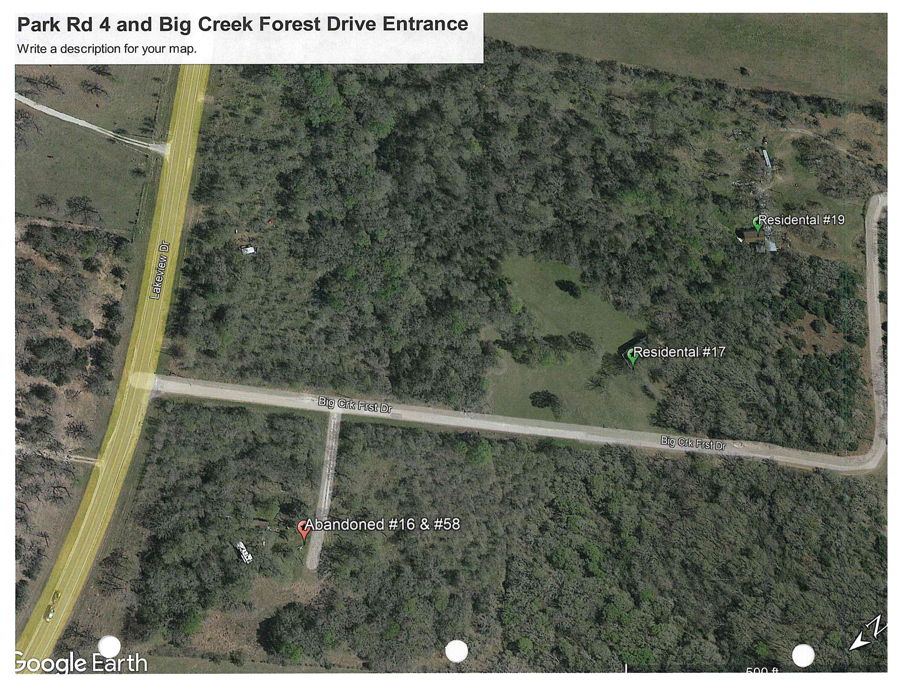
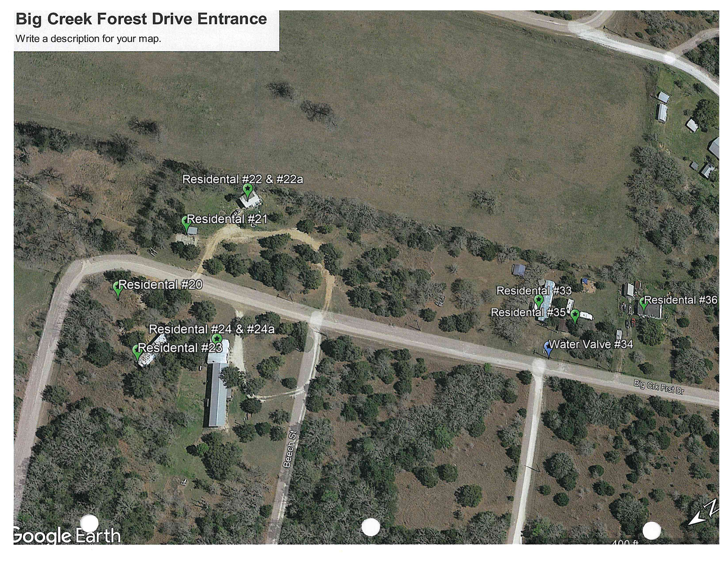
MAps

Slide 12
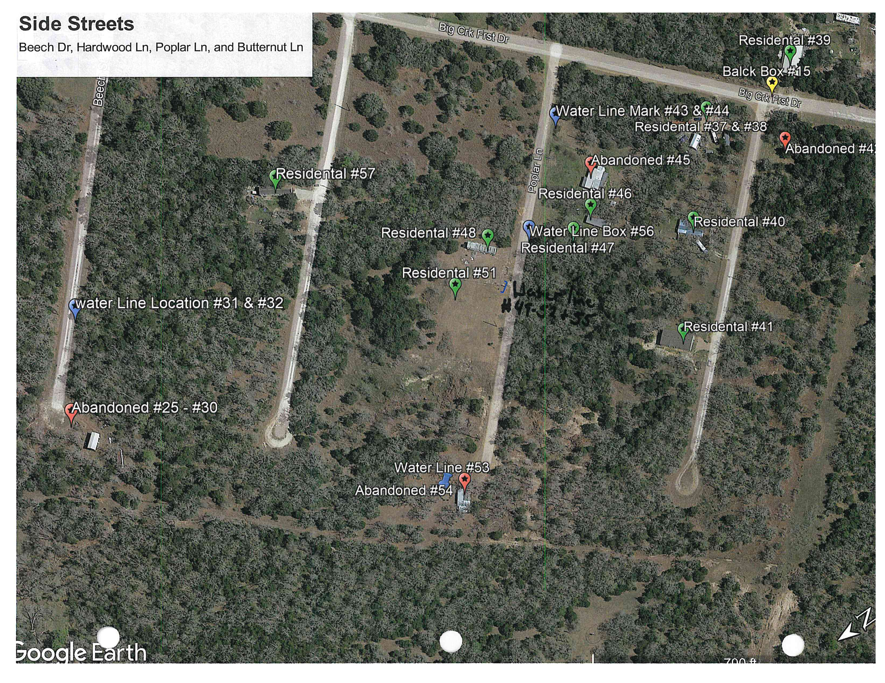
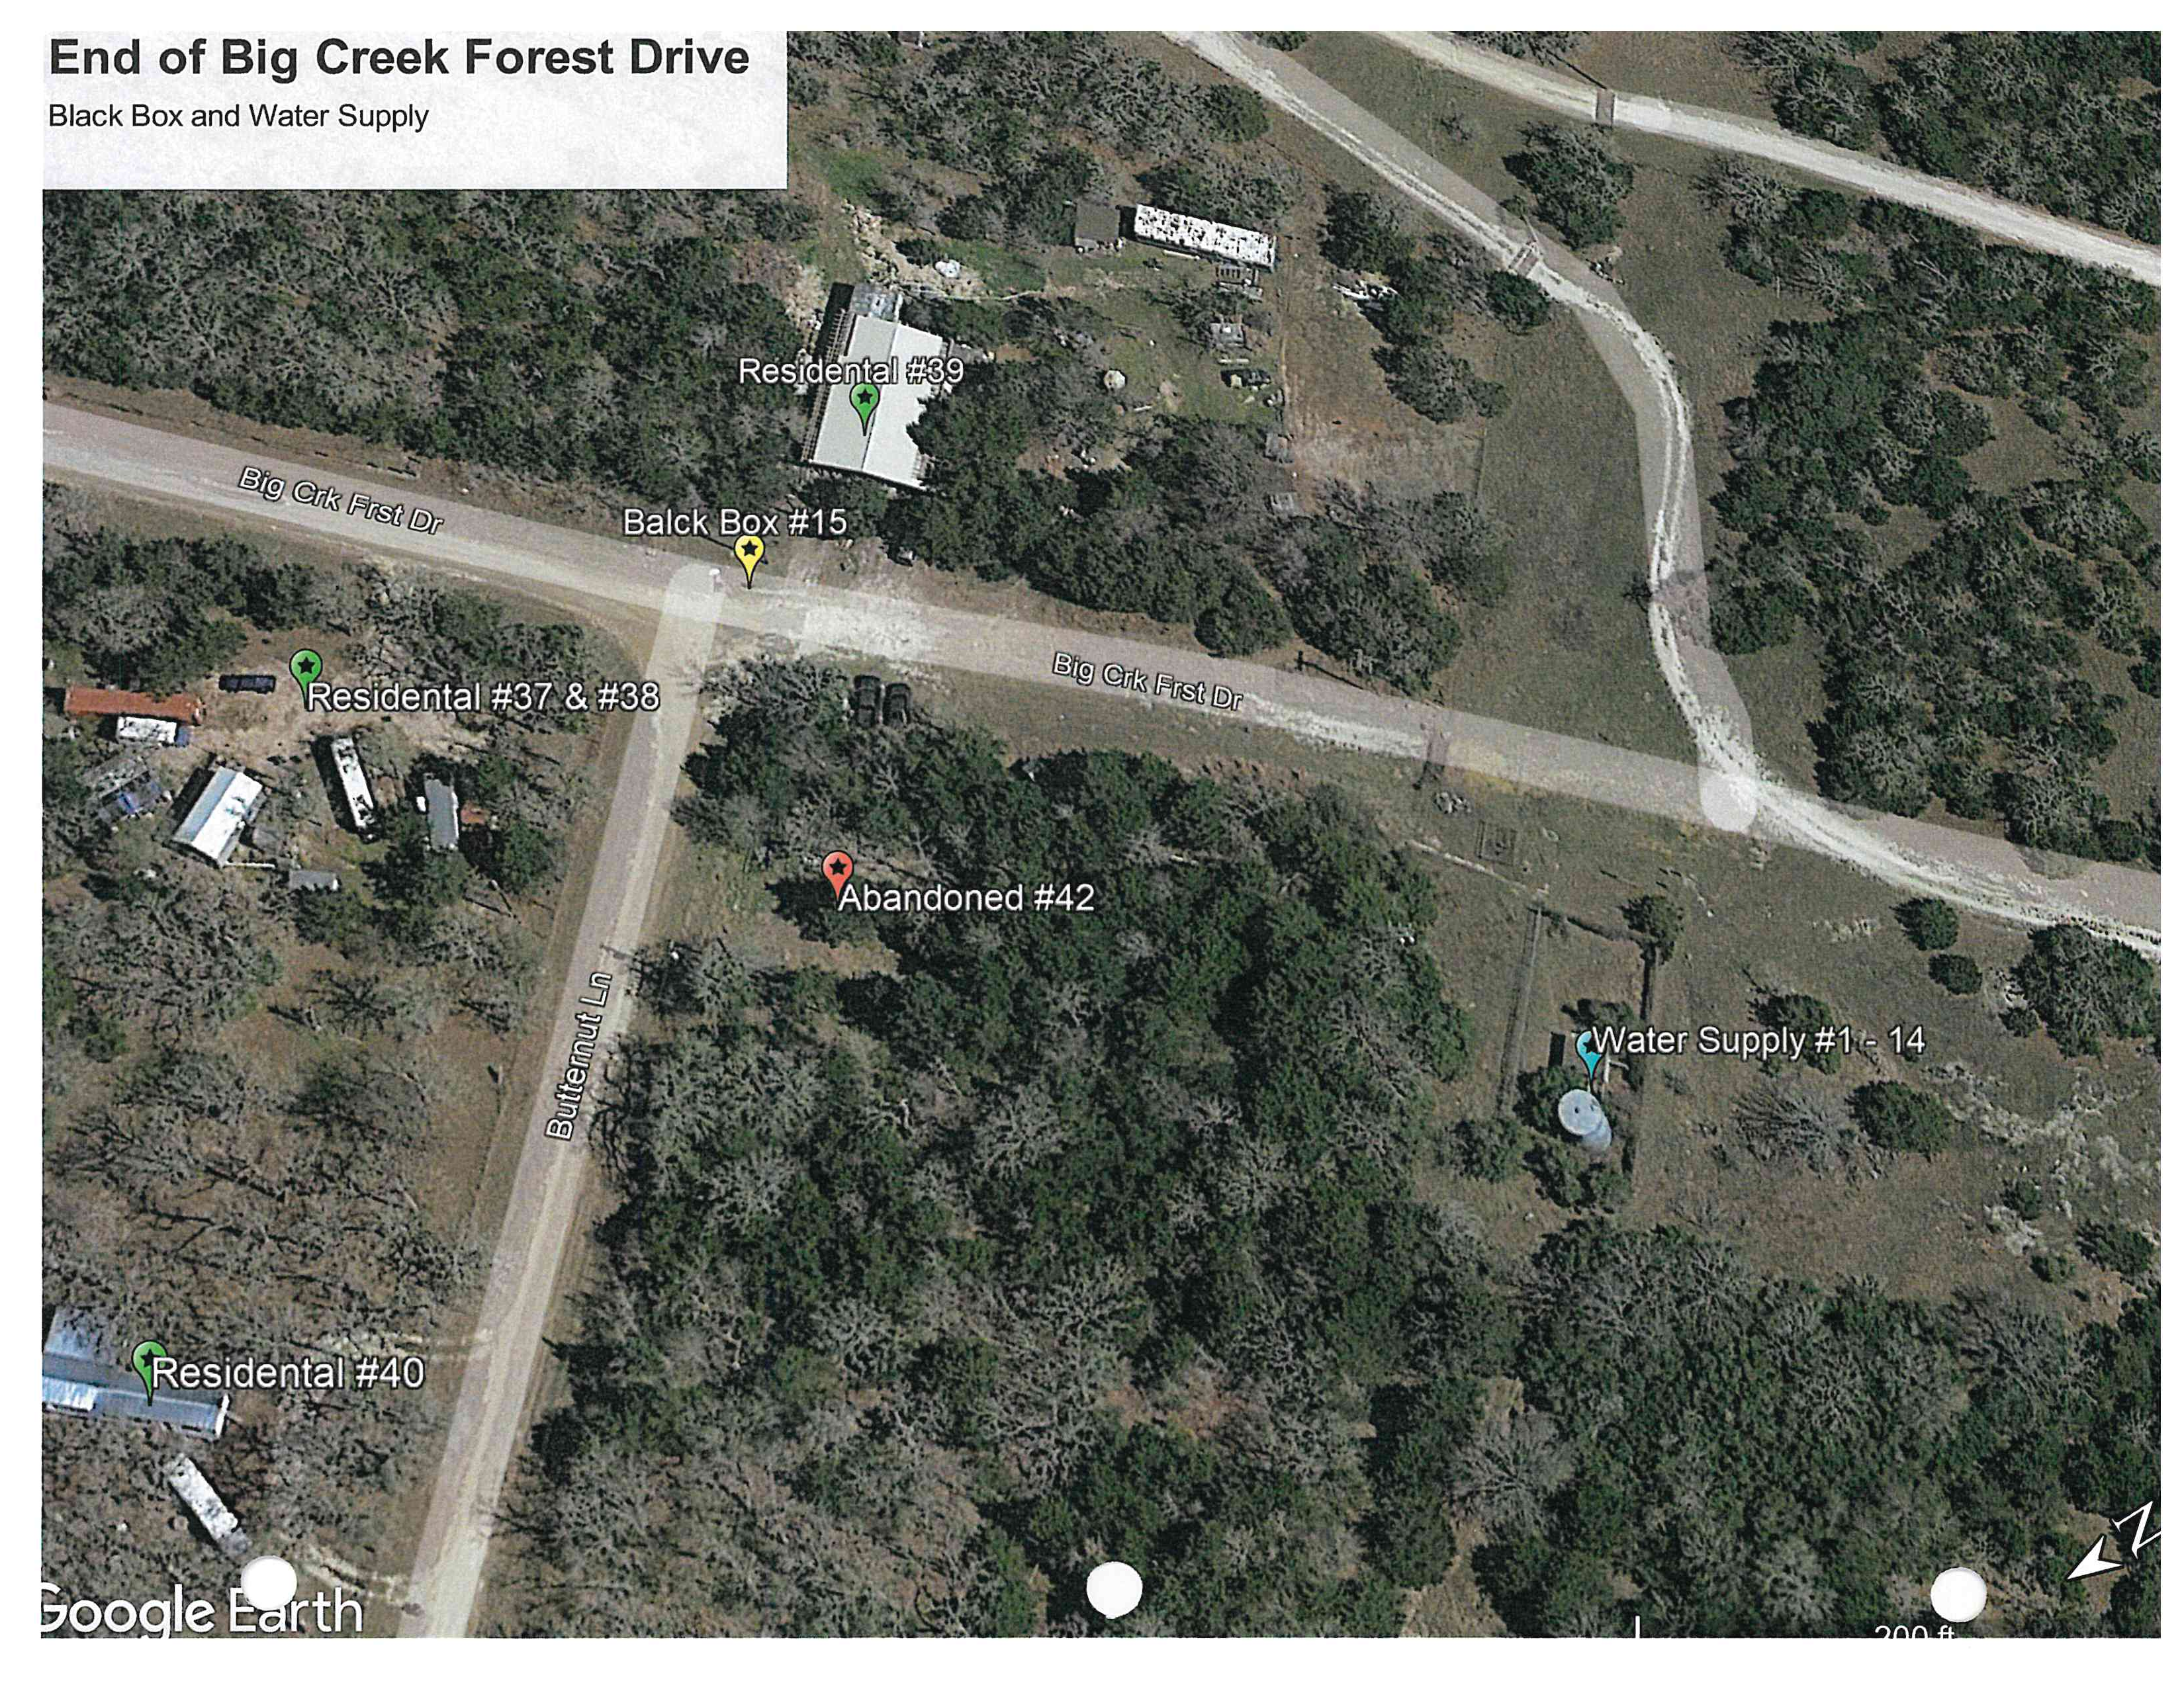
MAps

Slide 13
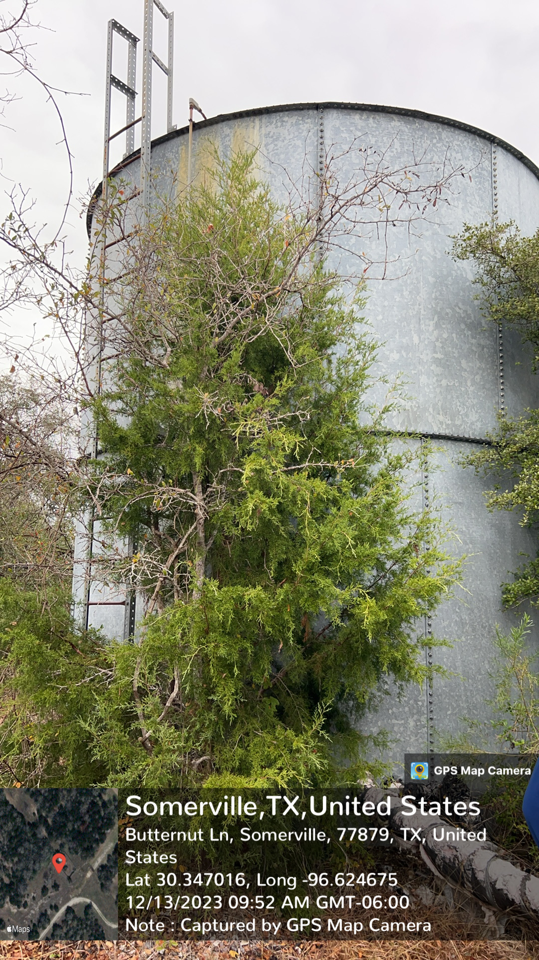
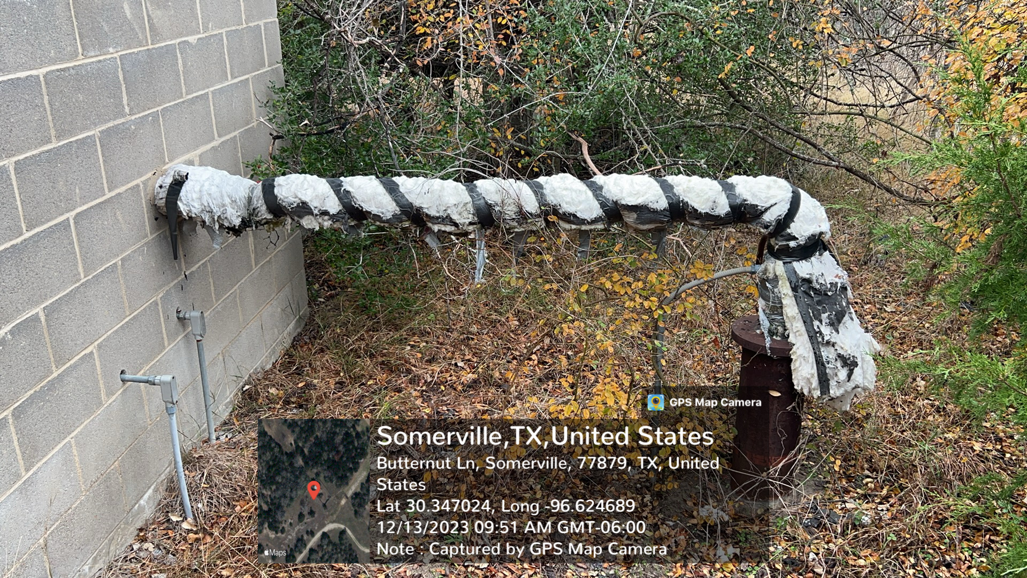
Investigation On 12-3-2023
POSGCD Staff conducted a site visit to the abandoned PWS.

Slide 14
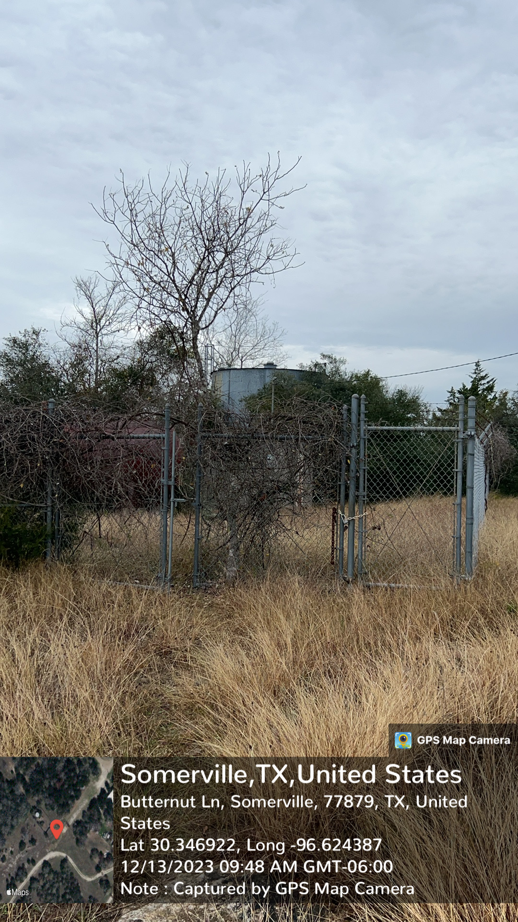
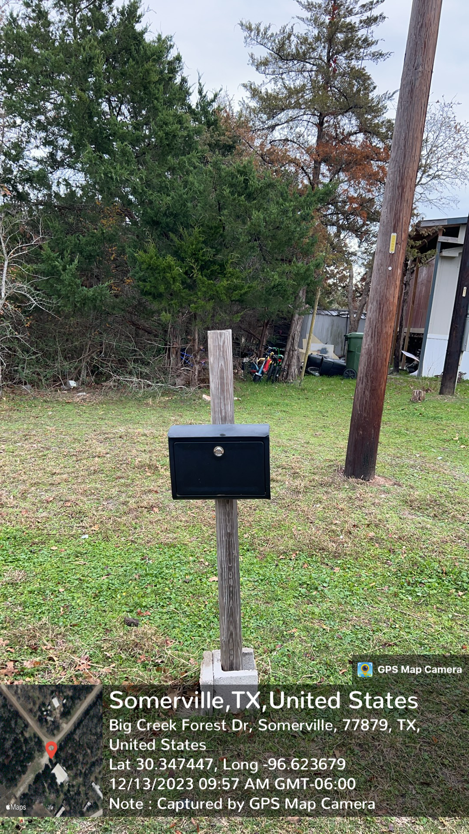
Investigation On 12-3-2023
Cont.

Slide 15
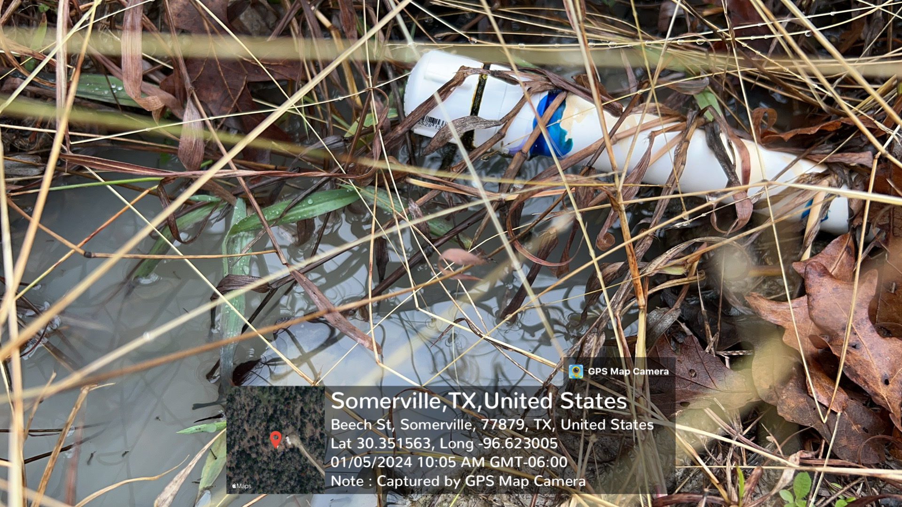
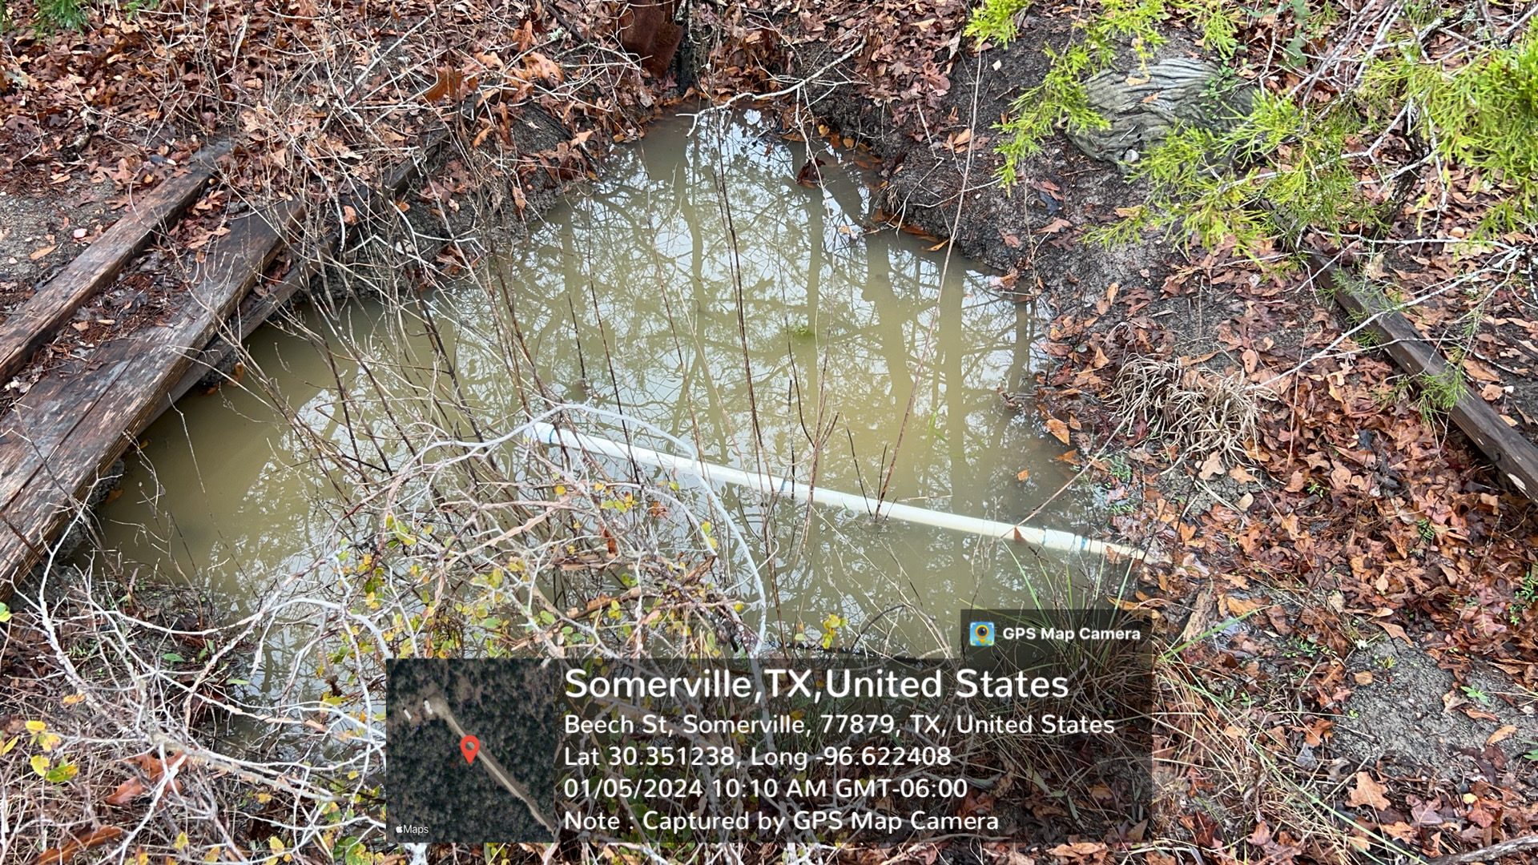
Investigation On 1-5-2024

Slide 16
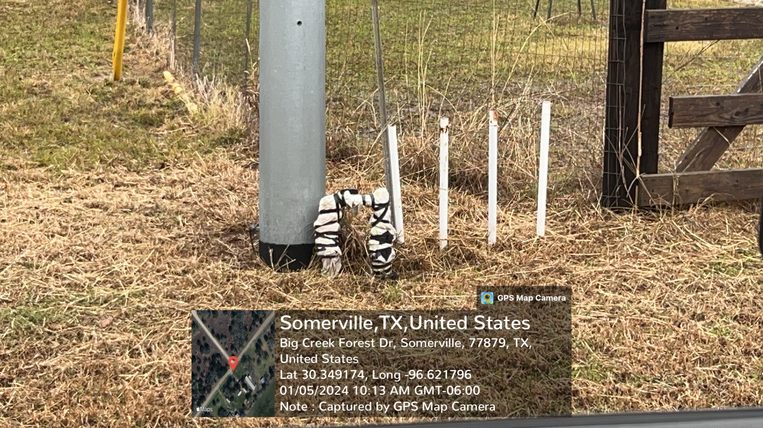
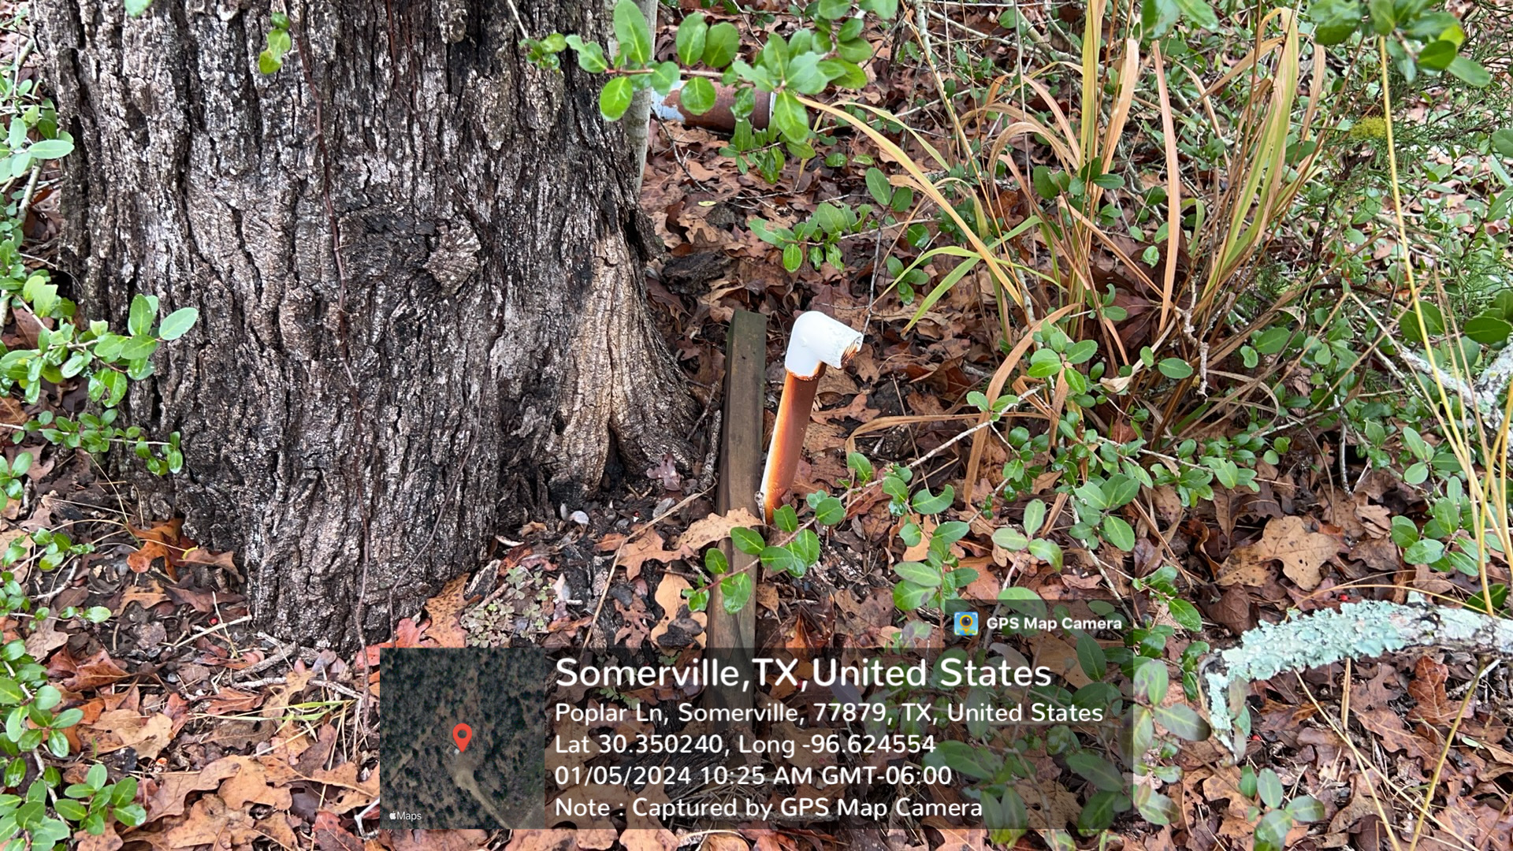
Investigation On 1-5-2024 Cont.

Slide 17
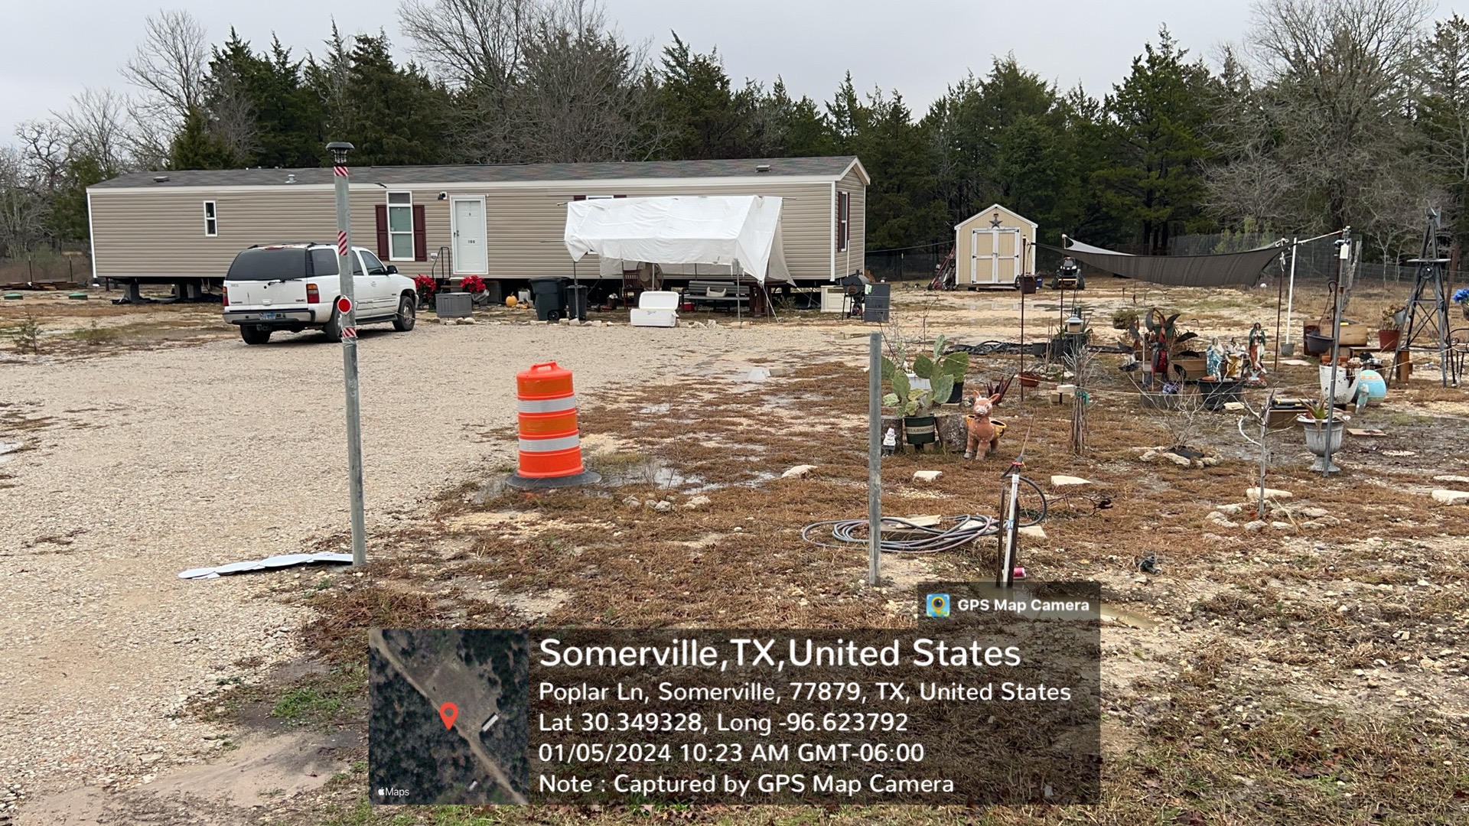
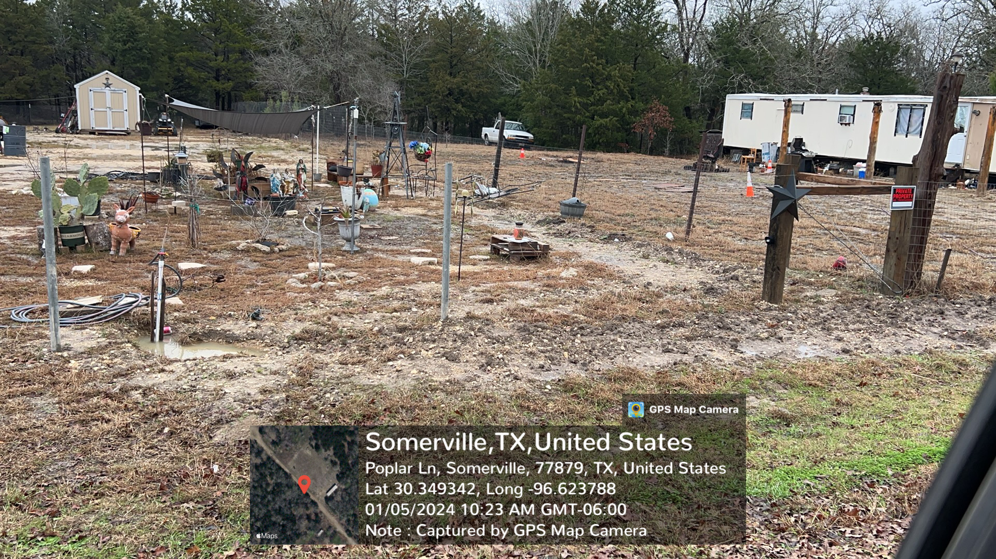
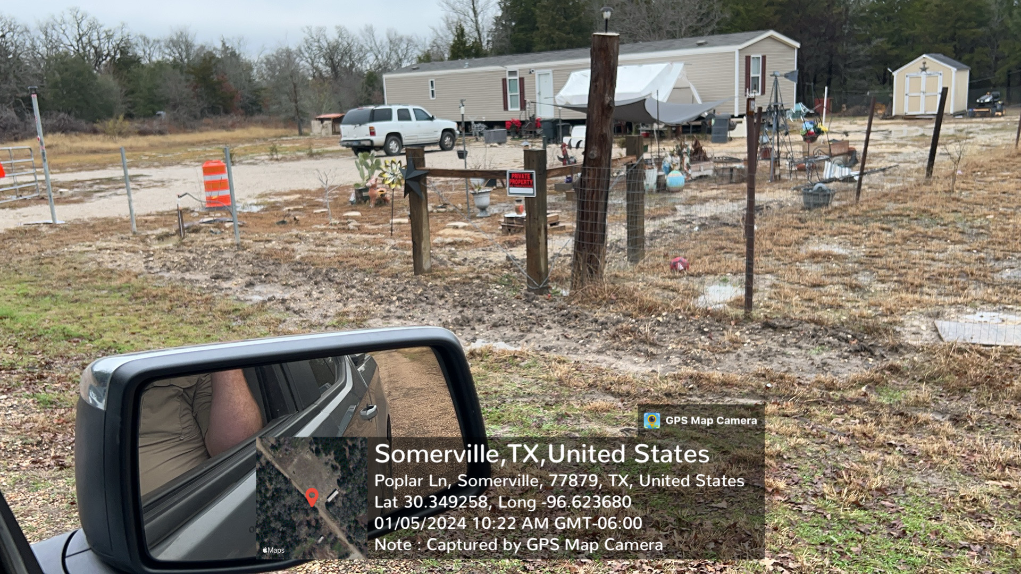
Investigation On 1-5-2024 Cont.

Slide 18
Latest updates As of 2/13/2024
February 8, 2024 – District Legal Council followed up with TCEQ
February 9, 2024 – TCEQ responded saying an investigation has been opened.

Slide 19
Agenda
f) Brief overview of District management strategies of groundwater resources
g) Update from Staff on progress of bid process for District Education Center and offices

Slide 20
Agenda
8. EXECUTIVE SESSION: Pursuant to Section 551.071 and 551.072, Texas Government Code, the Board of Directors only will consider receiving legal advice on the following matters:
a. Pending SOAH Docket Nos. 965-23-21218 and 965-23-21219, Application of SLR Property I, LP for a new 9,000 acre-foot per year Simsboro and Hooper Drilling and Operating Permit and Application of SLR Property I, LP for a new 15,000 acre-foot per year Simsboro Operating Permit- Discussions with the Board only.
b. Construction of District Education Center and Offices on Holdiness Lane in Milano, Texas

Slide 21
Agenda
9. RECONVENE FROM EXECUTIVE SESSION: Take action on matters discussed in Executive Session:
a. Pending SOAH Docket Nos. 965-23-21218 and 965-23-21219, Application of SLR Property I, LP for a new 9,000 acre-foot per year Simsboro and Hooper Drilling and Operating Permit and Application of SLR Property I, LP for a new 15,000 acre-foot per year Simsboro Operating Permit- Discussions with the Board only.
b. Construction of District Education Center and Offices on Holdiness Lane in Milano, Texas

Slide 22
Agenda
10. Dates, locations, and times of future meetings
11. Adjourn Board Meeting

