Slide 1
Post Oak Savannah Groundwater Conservation district meeting
January 9, 2024

Slide 2
188 Youth Since 2017
56% Female (105); 44% Male (83)

Slide 3
57% of students graduated high school with 2 or more years in the program.

Slide 4
Summer 4-H20 Leadership Academies
Tier I June 11-17
Tier II June 25-29
Tier III July 16-20
Tier IV July 30 – August 3

Slide 5
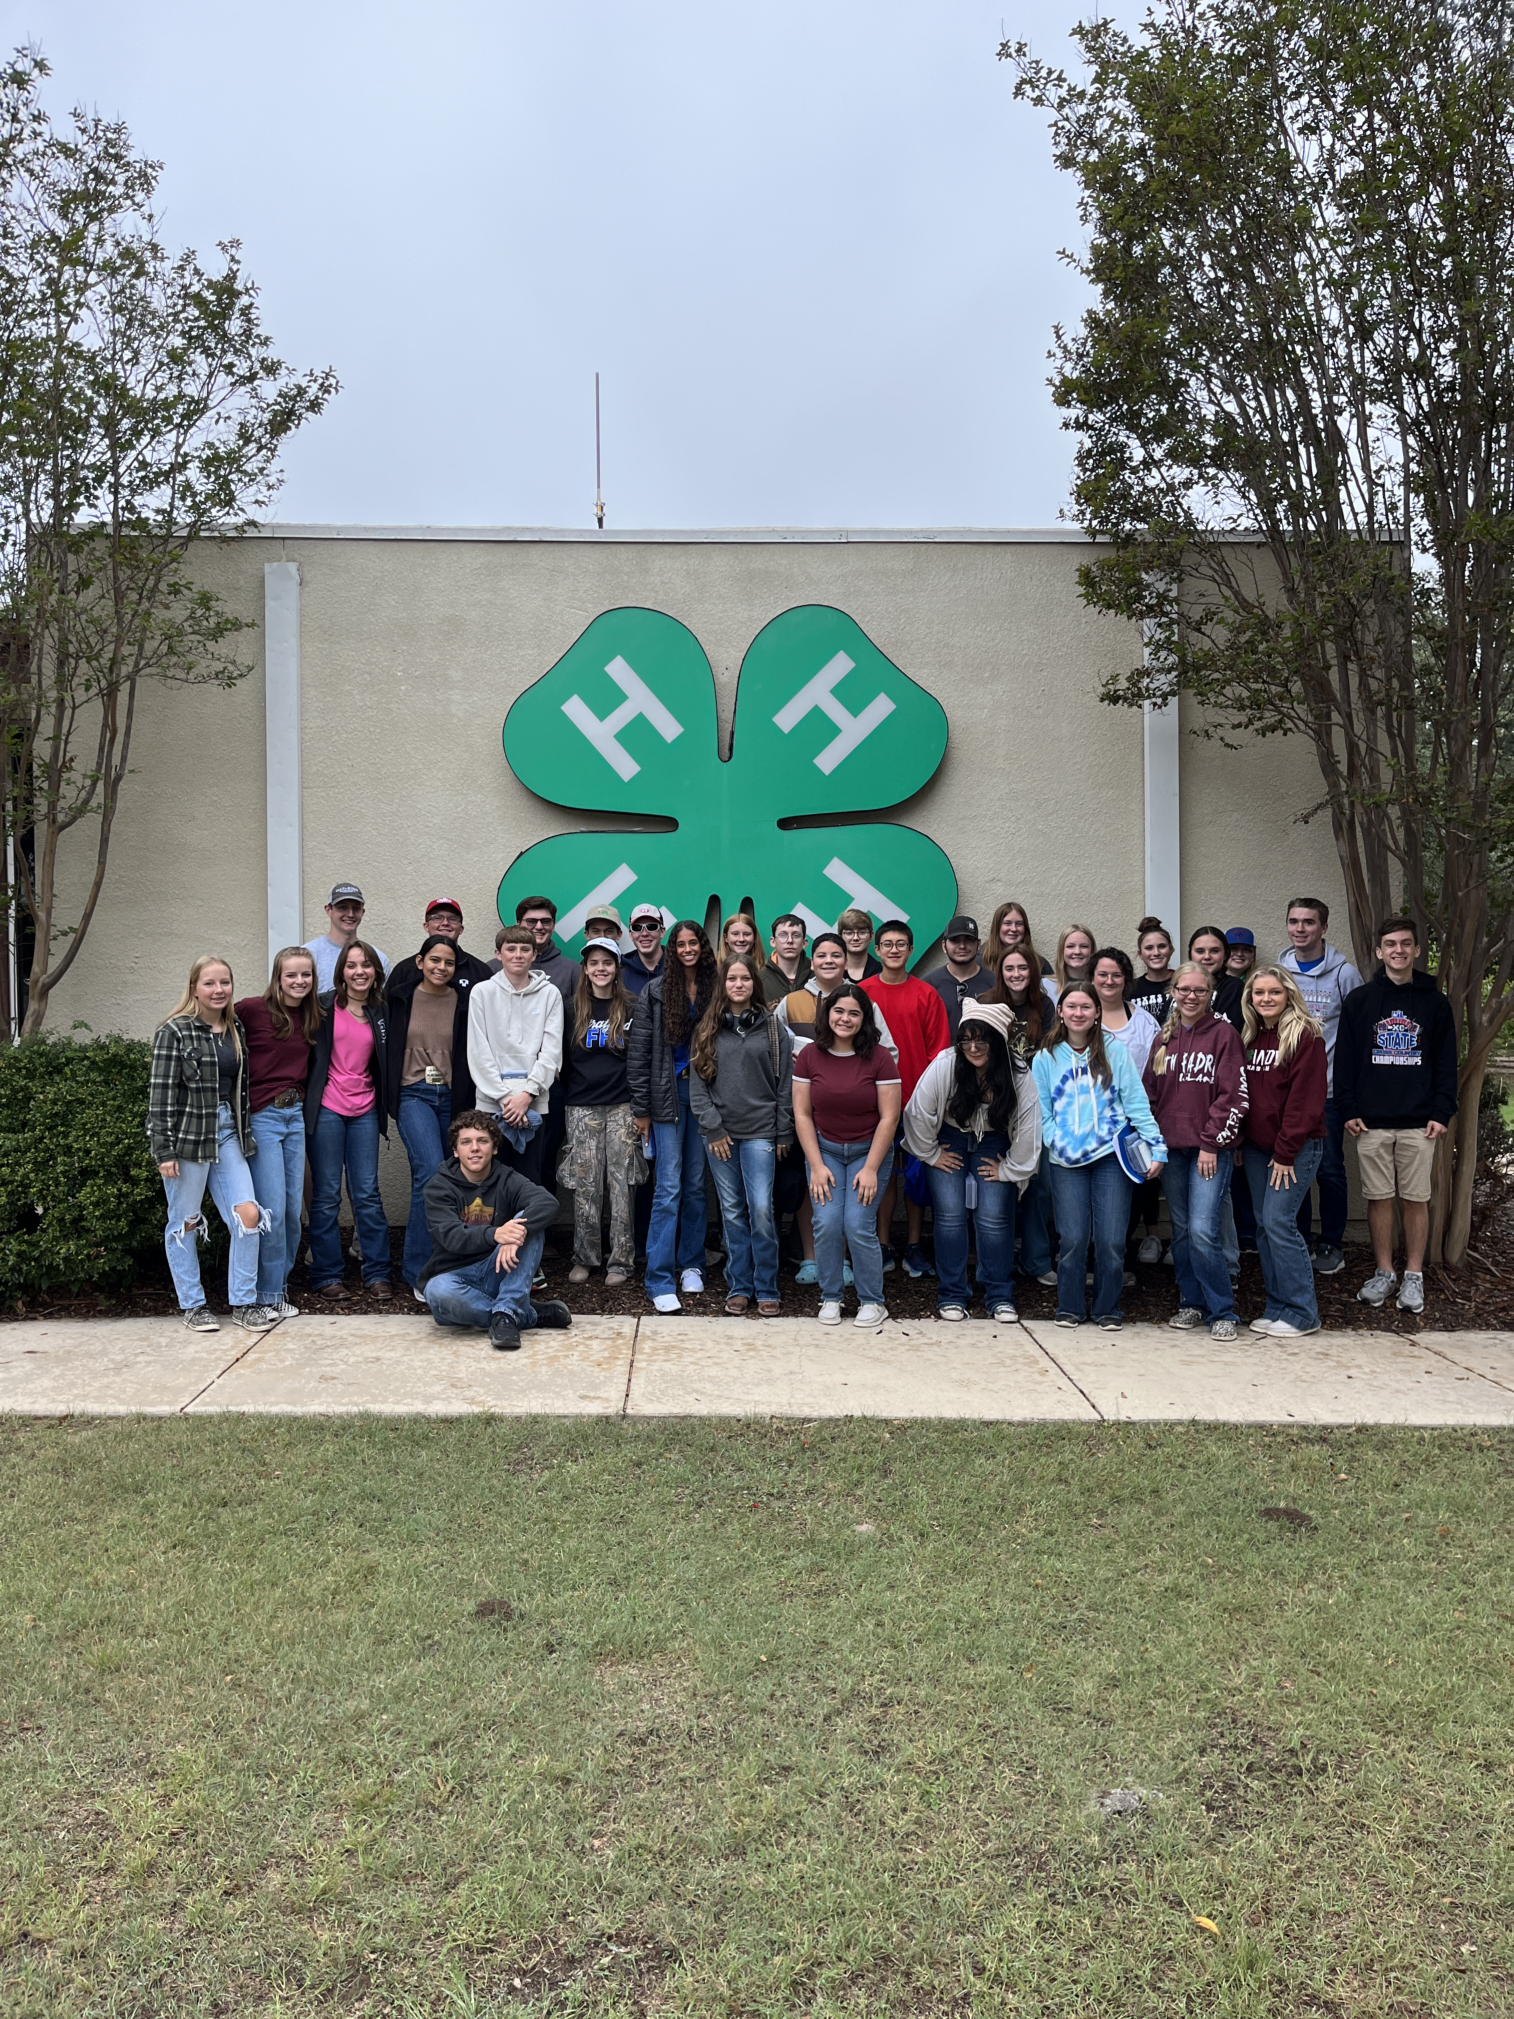
Fall Retreat October 27-29 Lake Brownwood
State Water Planning Activity
Community Water System Model Building
Mock Town Hall
Water Education Activities Training

Slide 6
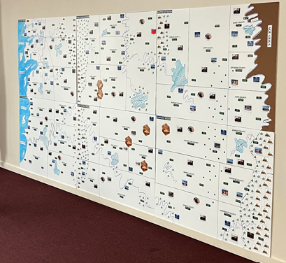
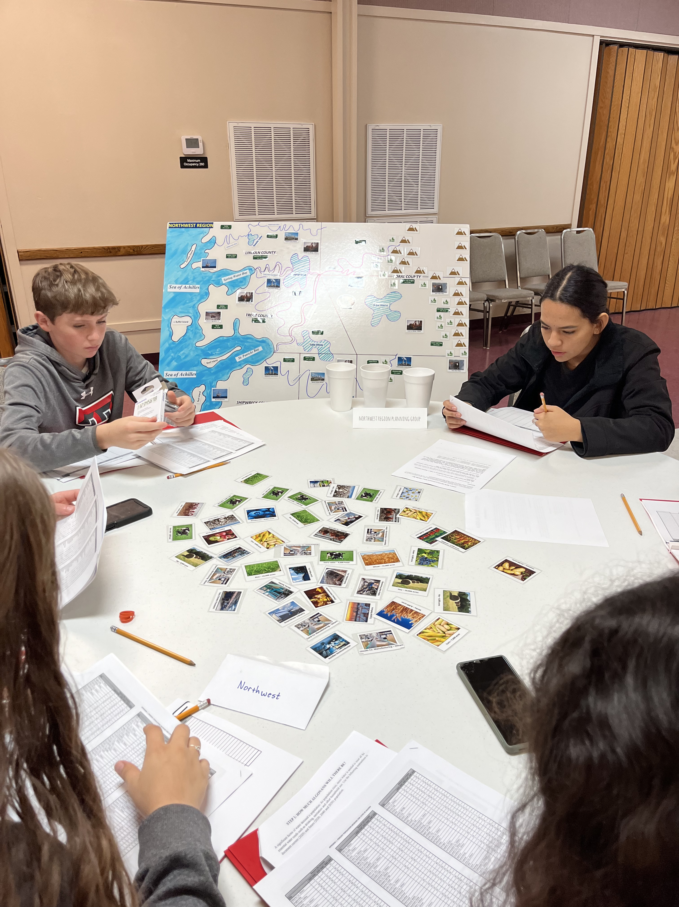
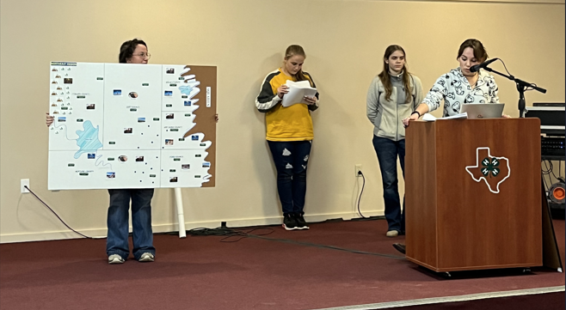
State water planning activity

Slide 7
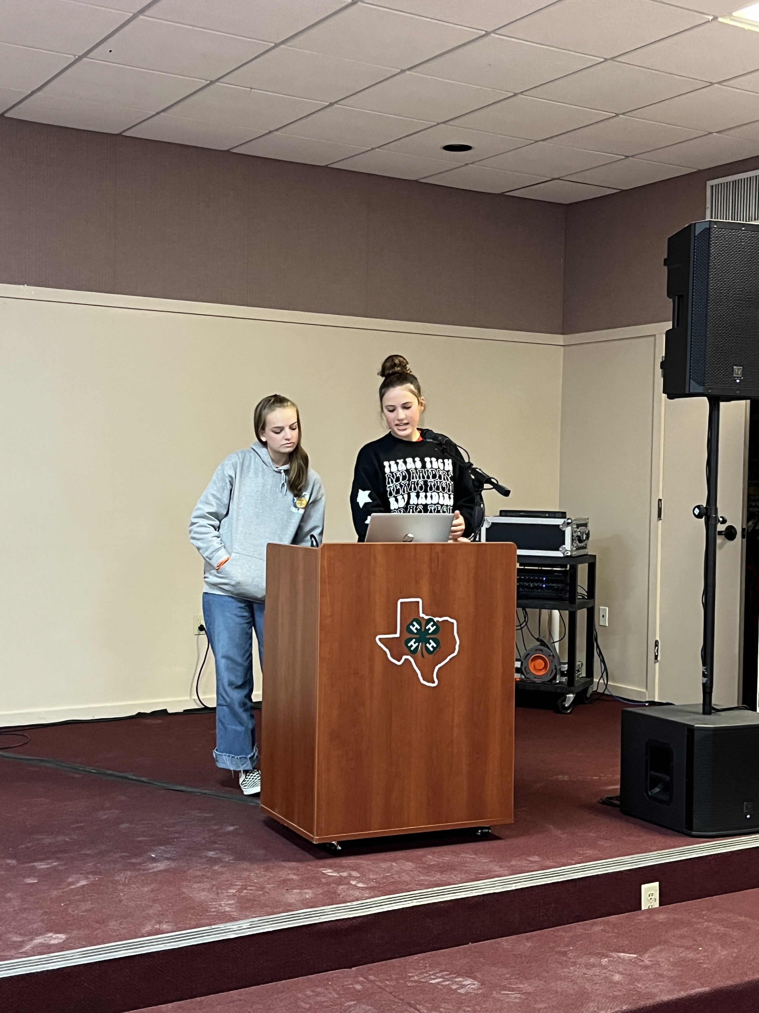
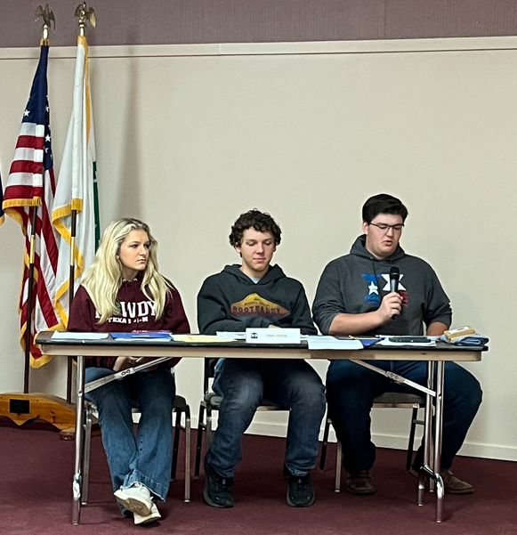
Mock Town Hall Meeting

Slide 8
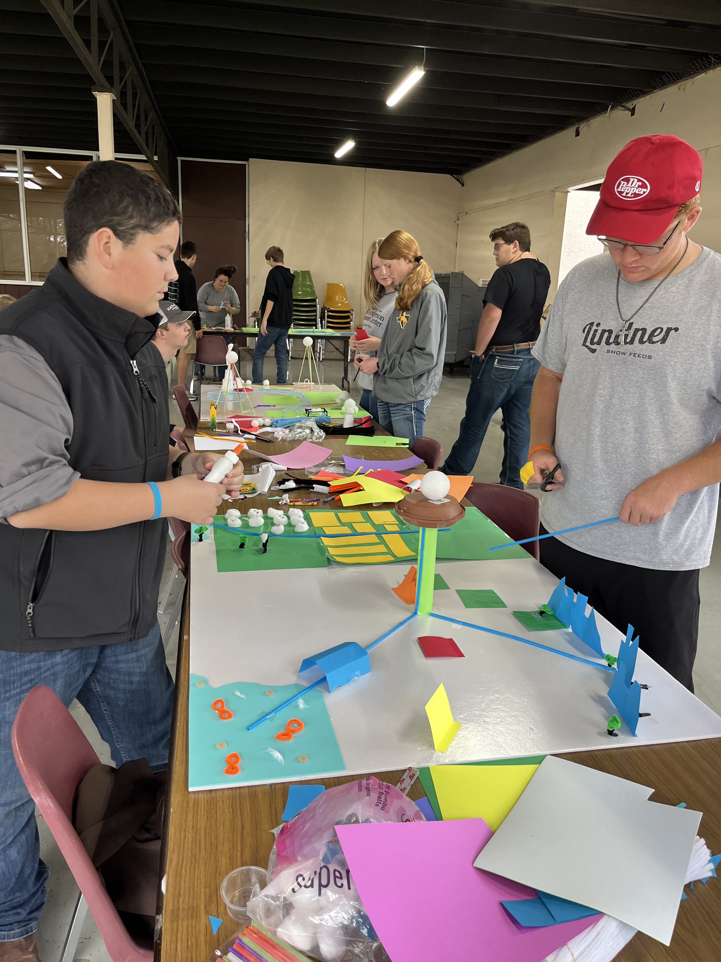
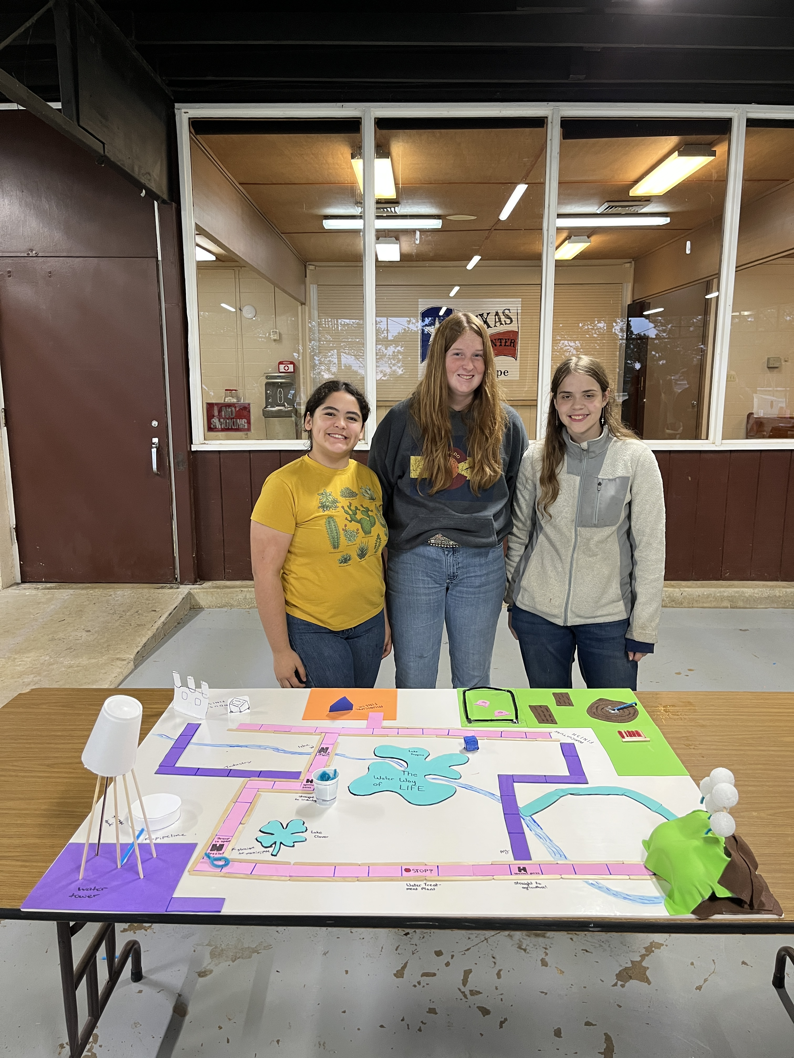
Model building activity

Slide 9
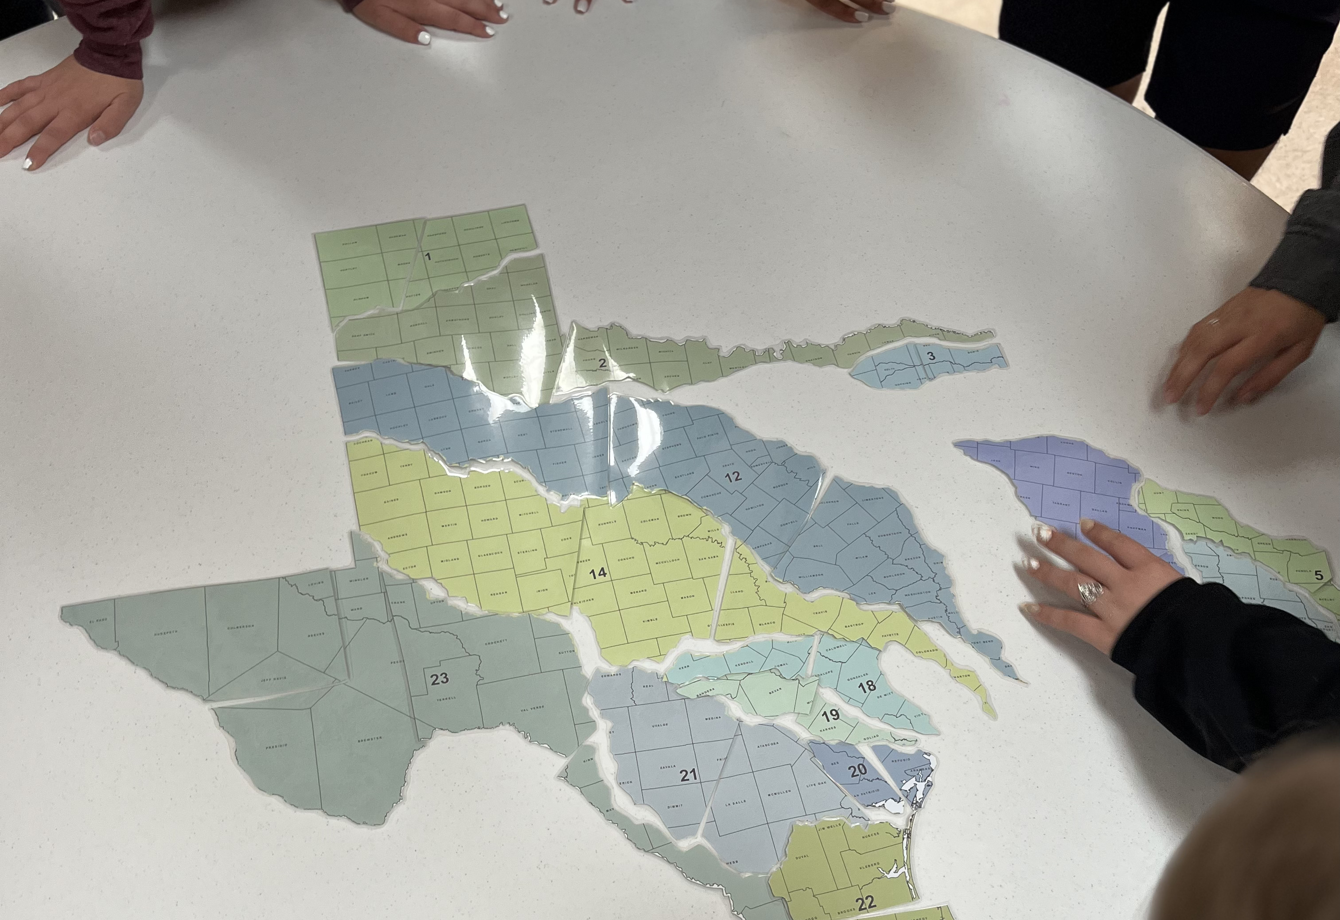
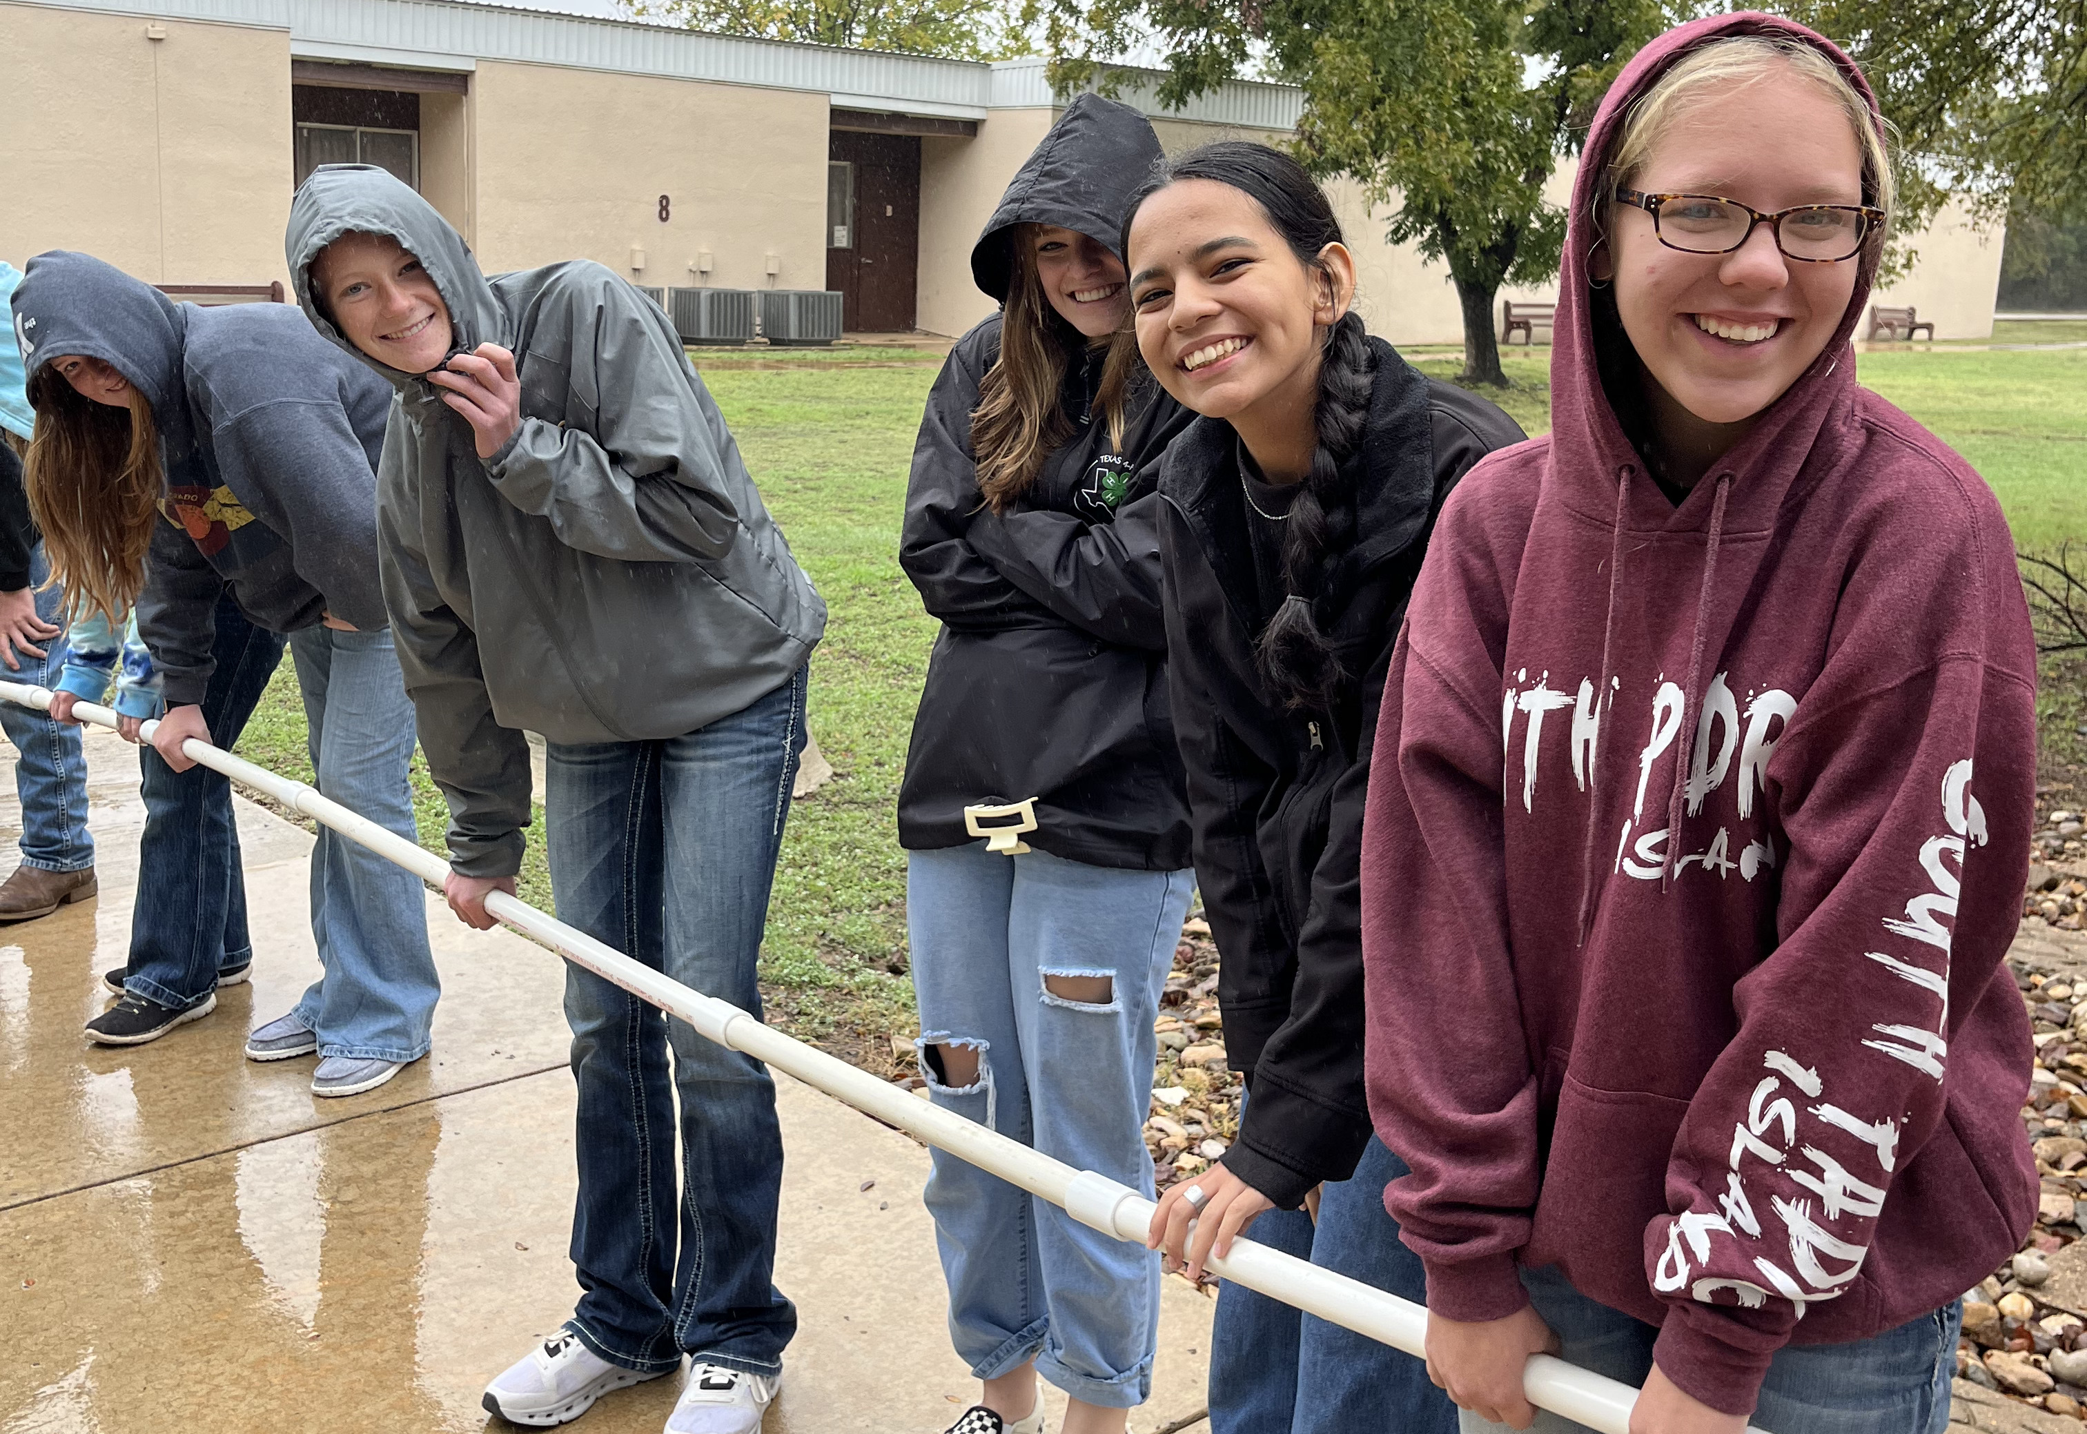
Water Education activities

Slide 10
Continuing Education
Monthly assignments
Zoom seminars
Conferences

Slide 11
2023 Zoom Seminars
Michelle Wood-Ramirez – Tarrant Regional Water District
Allison Thomason – TAMU Agricultural Systems Management & Agricultural Engineering
Leanne Wiley – Texas A&M AgriLife Extension, Soil & Crop Sciences
A Watershed Level Approach
January 19
A Sneak Peek into BAEN & AGSM
February 23
Lone Star Healthy Streams
March 23

Slide 12
2023 Zoom Seminars
Jenna Covington - North Texas Municipal Water District, Heather Ramsey - San Jacinto River Authority, Jill Garcia - Upper Trinity Groundwater Conservation District, Adeline Fox – Texas Ground Water Association
David Smith – Texas A&M AgriLife Extension
Dr. Waynn Morgan – TriMor Consultants, LLC, James Kiolbassa – Baker Hughes
Water Industry Career Panel
April 20
A Dive into Texas Water
September 21
Industrial Water
October 27

Slide 13
2023 Zoom Seminars
Jason Knobloch – Texas Rural Water Association
David Smith – Texas A&M AgriLife Extension
Source Water Protection
November 9
Water Infrastructure
December 14

Slide 14
Ambassador Service Activities
2,972 hours of reported service
38,578 contacts
$94,830 in volunteer time

Slide 15
4-H Clubs, Schools, community events

Slide 16
Plans for 2024
Promote & select new cohort – Mar/Apr
Lone Star 4-H Splash Camp – Apr 26-28
Tier I-IV Summer Academies – Jun/Jul
Fall Retreat – Oct ’24
Exhibit at Water Industry Conferences
Assignments & Seminars - Monthly

Slide 18
Thank you for your support!

